Slide 1


Phishing Attacks
Presentation
Md. Riajur Rahman Reday
Software Engineer | Major in Cyber Security

Slide 2




Table Of Contents
Introduction
Recognition
Prevention
Social Engineering
Understanding Phishing Attacks
Recognizing Phishing Emails
Avoiding Phishing Attacks
Protecting Against Social Engineering Tactics

Slide 3


01
Understanding Phishing Attacks
What is Phishing?
How Phishing Works

Slide 4

What is Phishing?
Phishing is an attempt by cybercriminals posing as legitimate institutions, usually via email, to obtain sensitive information from targeted individuals.

Slide 5
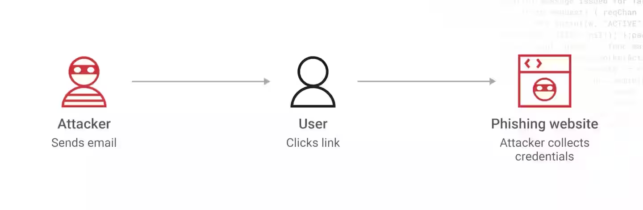
How Phishing Works
Anatomy of a phishing attack:
Common phishing techniques
The attacker sends a deceptive message designed to trick the recipient into revealing sensitive information or performing a malicious action.
Spoofed sender addresses, Urgency and fear tactics, Fake websites, and Malicious attachments or links.

Slide 6
02
Recognizing Phishing Emails
Signs of a Phishing Email
Examples of Phishing Emails

Slide 7

Signs of a Phishing Email
Unusual sender addresses or domains.
Generic greetings or overly formal language.
Urgent requests for personal information or immediate action.
Suspicious attachments or links.

Slide 8
03
Avoiding Phishing Attacks
Best Practices for Avoiding Phishing Scams
Training and Awareness

Slide 9

Best Practices for Avoiding Phishing Scams
Never click on suspicious links or download attachments from unknown sources.
Verify the authenticity of emails by contacting the sender through a trusted communication channel.
Use security software with anti-phishing capabilities.
Enable multi-factor authentication (MFA) for online accounts.
Regularly update passwords and be cautious when sharing personal information online.

Slide 10
Training and Awareness
Importance of ongoing security awareness training for employees and individuals.
Conduct phishing simulation exercises to test employees' ability to recognize and report phishing attempts.

Slide 11
04
Protecting Against Social Engineering Tactics
What is Social Engineering?
Common Social Engineering Techniques.

Slide 12

What is Social Engineering?
social engineering is the psychological manipulation of people into performing actions or divulging confidential information.

Slide 13

Common Social Engineering Techniques
Authority impersonation: Pretending to be a trusted figure, such as a colleague or IT support technician.
Pretexting: Creating a fabricated scenario to gain the target's trust.
Tailgating: Physically following someone into a restricted area.
Baiting: Offering something enticing to lure victims into taking action.

Slide 14
Thank you!

